Slide 1
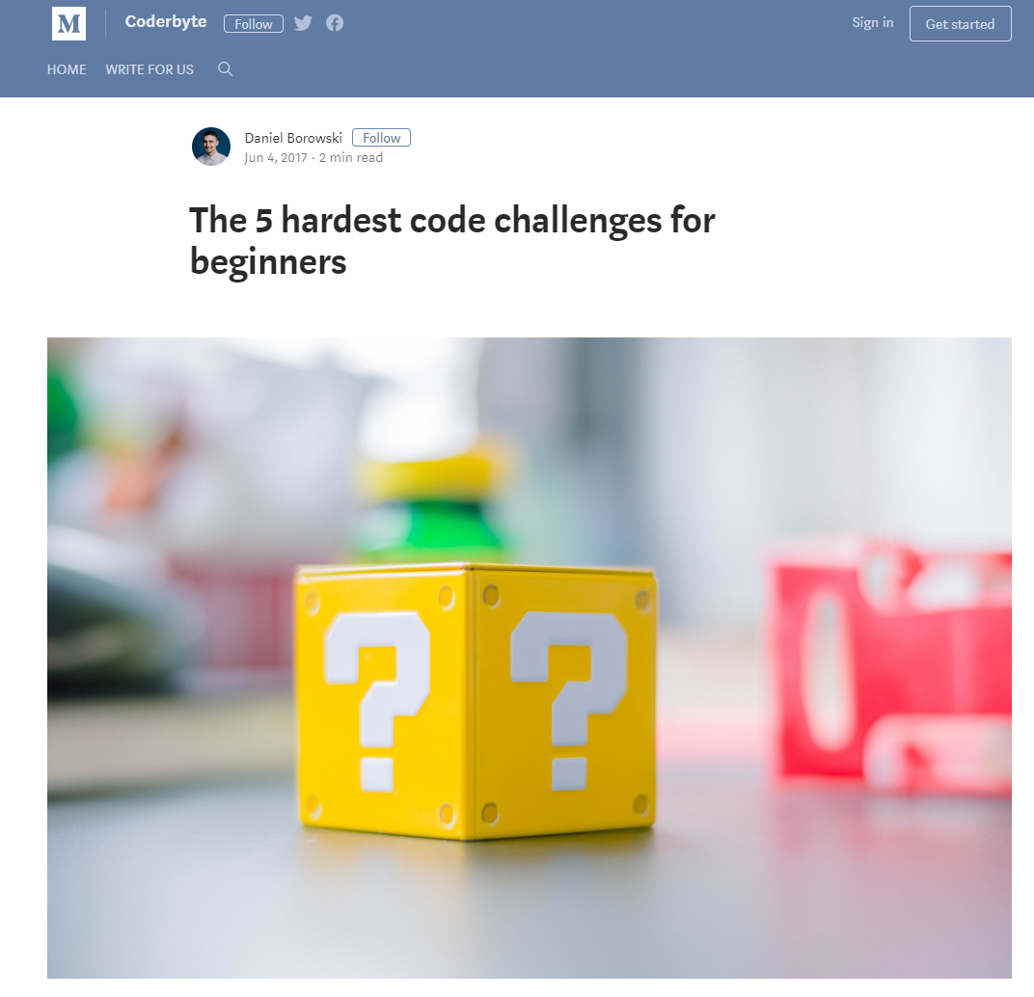
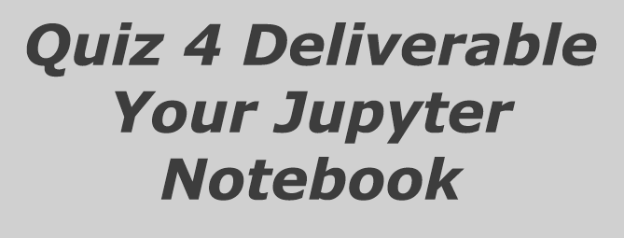
THE HANDS-ON IMPERATIVE
Submit your work to:
http://bit.ly/Quiz4-Hackathon

Slide 2
A word of warning here: as a general rule using “from X import *” is considered really bad form in Python because it means every object (* is a “wildcard” and means everything) is imported by its own name into your program, rather than part of the X namespace.
So, in our previous examples we’ve used import random, then accessed the randint()function via the random namespace: random.randint().
Had we used from random import *, then we could have said randint() and not random.randint().
However, this would be a bad thing to do. If you have two packages X and Y, each of which has its own object called x, then, if you use “import *” the two objects X.x and Y.x will both end up in your program called ‘x’.
As you don’t have the X and Y namespaces to distinguish them, they ‘collide’.
So, why am I using “import *” for you? Because Tkinter is an exception.
The Tkinter package has been designed so that as few objects as possible are imported into your program, and because their names are specifically GUI related, so there is less risk of a naming collision.
If you are feeling uneasy about all this do multiple imports of the specific Tkinter components you need.

Slide 3
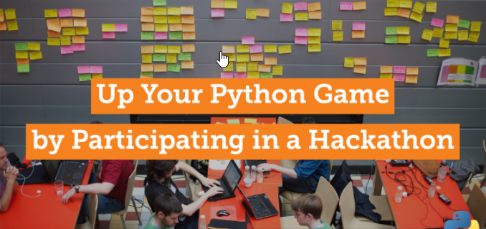

Slide 4

Each Team will receive 4 Challenges
You will receive 25% for each challenge completed successfully.
Partial Marks MAY be awarded for partial but not complete code

Slide 5
Challenge 1: Write a Python Program to collect all team members names and student numbers from the command line and write them out to a Text File
Submit your work to:
http://bit.ly/Quiz4-Hackathon

Slide 6
Challenge 2: Add the first 100 integers
For Loops are written in the following format:
for i in range(1,10):
#do something!!!

Slide 7
Challenge 3: Recursion
Using this definition for a RECURSIVE FUNCTION,
Print out the factorials of the numbers: 1 to 10
For Loops are written in the following format:
def factorial(n):
if n == 1:
return 1
else:
return n * factorial(n-1)
for i in range(1,10):
#do something!!!
Recursion is a way of programming or coding a problem, in which a function calls itself one or more times in its body. Usually, it is returning the return value of this function call. If a function definition fulfils the condition of recursion, we call this function a recursive function. Termination condition: A recursive function has to terminate to be used in a program. A recursive function terminates, if with every recursive call the solution of the problem is downsized and moves towards a base case. A base case is a case, where the problem can be solved without further recursion. A recursion can lead to an infinite loop, if the base case is not met in the calls.

Slide 8

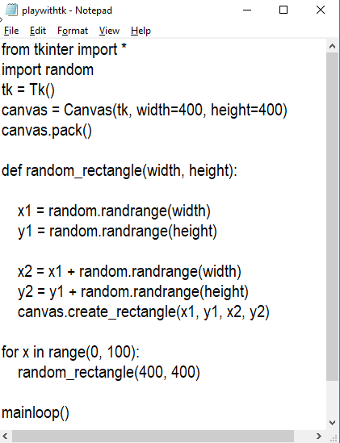
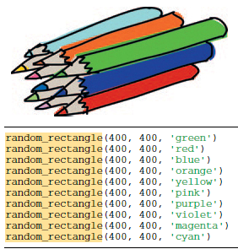
Extend this starter code to change the background color of the Canvas, using the example code shown on the right:

